Slide 1
Thousand Block Pooling

Slide 2
Number Block Pools
In the US, the process of creating and managing pools of telephone numbers in blocks of a thousand is set out in ATIS-0300119
A unique thousand-block pool is required for every Rate Centre where number portability is in effect
A pool is created using thousands-blocks donated to the pool by Service Providers (SPs) and NXXs opened through a pool replenishment process
Thousand Blocks are identified as NPA-NXX-X
Applies only to specific Rate Centers where Location Routing Number (LRN) LNP has been implemented; and Thousands-Block Number Pooling has been mandated
2024

Slide 3
Thousand Block Pooling
Obilgations – New or Modified General Requirements
A Thousands-Block Holder shall (not exhaustive list):
within five (5) calendar days of the issuance of the Part 3A Pooling Administrator’ Response/Confirmation, enter the Thousands-Block routing and rating information into BIRRDS
arrange for the entry of any information to the Line Information Data Base (LIDB), or other Service Provider (SP)-specific databases due to receipt of a new Thousands-Block;
Arrange to update NPAC with LRN’s for assigned blocks
verify in the NPAC which TNs are Assigned in any contaminated Thousands-Block received from the PA to avoid duplicate TN assignments. The preferred method of contaminated TN verification relies on NPAC, but use of one's own LSMS (Local Service Management System) is also acceptable
complete and return the Part 4A Confirmation of Thousands-Block in Service to the PA;
2024

Slide 4
Thousand Block Pooling
Obilgations – New Block Forecasts
When pooling is first implemented in a rate center, and on a semi-annual basis thereafter for all rate centers in which they currently operate where pooling has been implemented. Carriers must also submit a revised forecast if their forecasted demand changes.
This means maintaining forecasts by OCN, NPA and Rate Centre. In the US, these are stored and accessible online by SP’s to update (without an on-line process, this would be a very complicated task)
2024

Slide 5
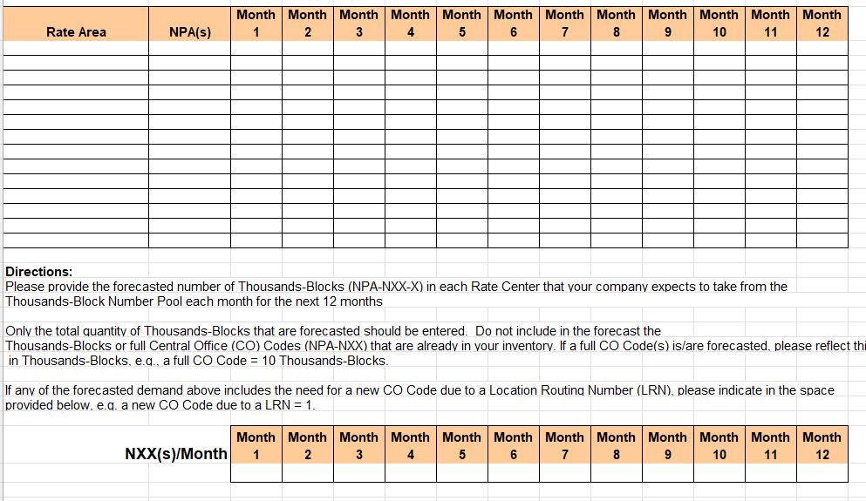
Thousand Block Pooling
2024
Obilgations – Block Forecasts Per ATIS 0300119 Appendix 4

Slide 6
Thousand Block Pooling
Obilgations – Inventory Maintenance
All Service Providers (SPs) shall maintain no more than a six-month Inventory of TNs in each Rate Center or service area in which it provides telecommunications service
At a minimum, SPs shall review their inventories at the Rate Center level for possible Thousands-Block Donations/returns semi-annually
SPs shall Donate/return Thousands-Blocks that are 10% or less contaminated unless SPs can demonstrate that: 1) the Thousands-Block is required to meet the SPs six-month projected forecast; 2) there are Technical Reasons which justify retaining Thousands-Blocks such as TNs that are Assigned to nonportable services; or 3) the Thousands-Block is an Initial Thousands-Block
** In the US, a Service Provider is defined as a Telecommunications Carrier or other entity that receives Numbering Resources from the North American Numbering Plan Administrator (NANPA), the Pooling Administrator (PA) or, from a Telecommunications Carrier for the purpose of providing or establishing telecommunications service
2024

Slide 7
Essential Forms
Part 1 Central Office Code (NPA-NXX) Application form used to request the assignment of a CO Code, modify an existing CO Code, or return a CO Code. Similar to previous Part 1 Form but with a pool indicator.
Part 1A Thousands-Block (NPA-NXX-X) Application form used to request a new Thousands-Block, reserve a new Thousands Block, modify an existing Thousands-Block or return an existing Thousands-Block. Where a new LRN required, a Part 1 application is also required.
Part 1B NPAC Thousands-Block Data form used to activate a Thousands-Block (NPA-NXX-X) in the NPAC, for an Intra-SP block-porting request; or for a modification to a block in the NPAC. One Part 1B is to be issued for each Thousands Block request. In the US, Applicants have a choice to initiate Pooled Thousands-Block activation through Service Order Activation (SOA) interface to Number Portability Administration Center (NPAC), or through NPAC personnel.
Part 3A Pooling Administrator’s Response/Confirmation form used to approve, suspend or deny an SP’s Part 1 or Part 1A application
Part 4 Confirmation of Code In Service form that is issued by the SP to confirm that an CO Code (NPA-NXX) is in service.
Part 4A Confirmation of Thousands-Block In Service form that is issued by the SP to confirm that an Thousands Block (NPA-NXX-X) is in service.
2024

Slide 8
Initial TB Pool Applications
2024
Initial Thousands-Block Pool Applications
This application is used when a Service Provider (SP) initiates service in a Rate Center that is part of number pooling. It uses a Part 1 and Part 1A form. If on-line system is used, these form can be combined.
Pooled CO Code assignment is required for the establishment of an LRN per Switching Entity/POI, provided the Applicant has no existing resources available for LRN assignment.
SP is allowed to use Intra-SP Ports to share Thousands-Blocks across their multiple switches in a Rate Center.
The requesting SP becomes the CO Code Holder of the Pooled CO Code with at least one one-thousand number block
Multiple Thousands-Blocks may be requested on an Initial Thousands-Block Application to open a Pooled CO Code. When requesting more than one Thousands-Block on an Initial Thousands-Block application, SPs shall provide a Thousands-Block Months to Exhaust (MTE) Certification Worksheet

Slide 9
Initial TB Pool Applications
2024
Initial Thousands-Block Pool Applications (continued)
Other regulatory requirements
Applicant must satisfy the license and/or Certification and facilities readiness requirements.
Applicant must file a thousand block forecast
Applicant must comply with NRUF filing requirements
There are Form 1B obligations for an initial co code that must be dealt with in the NPAC. Not clear if in Canada CNA will deal with these forms or users will deal directly with NPAC through SOA process.

Slide 10
Thousand Block Pooling
Growth Thousands-Blocks (NPA-NXX-X) Applications
These applications use a Part 1A form to order one or more available thousand-blocks from a rate centre pool.
Requirements include (not a full list):
Applicant shall provide a Thousands-Block MTE Certification Worksheet
A separate Part 1B NPAC Thousands-Block Data form is required for each Thousands-Block requested,
The PA shall Allocate a Thousands-Block to an SP's single Switching Entity/POI. The SP shall be allowed to use Intra-SP Ports to share that Thousands-Block across their multiple switches in a Rate Center
Growth applications can also involve code replenishment requests for the pool (US online system combines the Part 1 and 1A forms).
2024

Slide 11
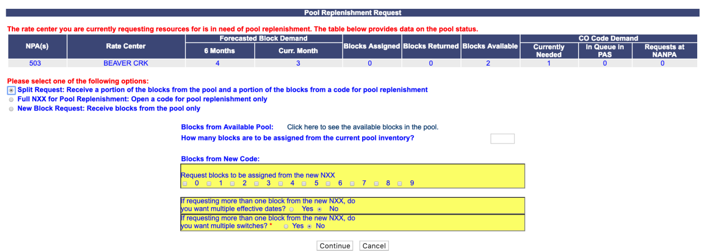
Source: Pooling Administration System (PAS) User Guide for Service Providers (SPs) And Service Provider Consultants (SPCs) Version 1.15
Thousand Block Pooling
2024
Growth Pooled Central Office (CO) Code (NPA-NXX) Applications
The need for a Growth Pooled CO Codes assignment occurs when a Service Provider (SP) requires additional blocks in Rate Center beyond the number of blocks in the pool. Assignment of Growth Pooled CO Code in a Rate Center uses the Part 1 and Part 1A form or electronic submission (combined).

Slide 12
New Data Requirements
In order for an SP to determine whether a SP need to request a pooled Central Office Code, or to select available blocks, there needs to be a PA report available indicating pool inventories. This can be determined at the time of an electronic application(if used) or from a publicly available tool. Example from US pooling administrator at www.nationalpooling.com provides the following tool:
2024

Slide 13
New Data Requirements
2024
From www.nationalpooling.com

Slide 14
Contact Us
ADDRESS
2024
202-70 East Beaver Creek Rd
Richmond Hill, ON L4B 1B3
PHONE NUMBER
(416) 915-5008
EMAIL
info@comsolveinc.com

